Slide 1




Job Slot Retention analysis
NIKITA GOSWAMI
DATA SCIENCE INTERN CANDIDATE 2020

Slide 2




While contract value is observed to grow across years, only 2 out of 3 are renewed; Higher the value driven* to partner or application per listing** higher the renewal rate
$ 1167
$ 995
$ 1010
70%
of all contracts
are renewed
Average contract value increases across years
*Value driven: Applications per contract value grouped into buckets based on percentile points
| **Applications per listing grouped into buckets based on percentile points

Slide 3
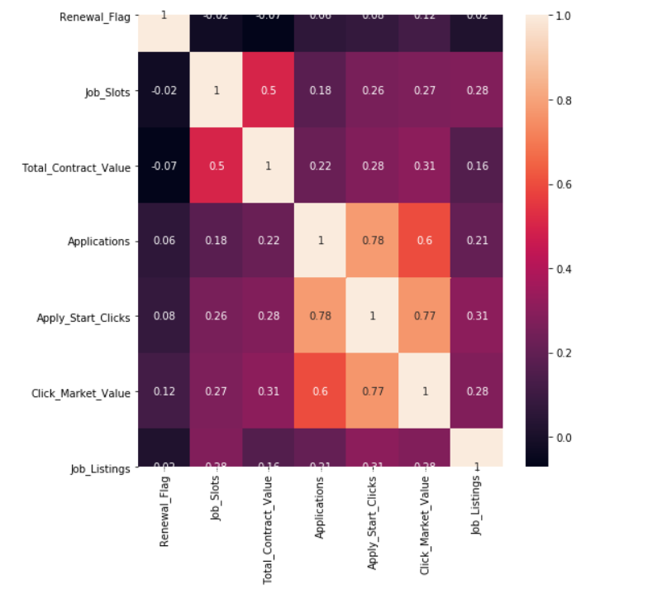
Most of the variables had a positive correlation with ‘Renewal Flag’, as expected and the Logistic regression model couldn’t help in attribution
All the variables have a positive relationship with each other and with Renewal.
Logistic Regression :
Logistic regression was leveraged to study the characteristics of variables in predicting renewal
Click market value had positive relationship with Renewal but other predictors were seen as negatively affecting the Renewal variable, which is counter-intuitive for attribution
There might be some non-linear relationship between variables and renewal, which will come to light in CART
CART can also provide ballpark numbers for business to define Service Level Agreements

Slide 4
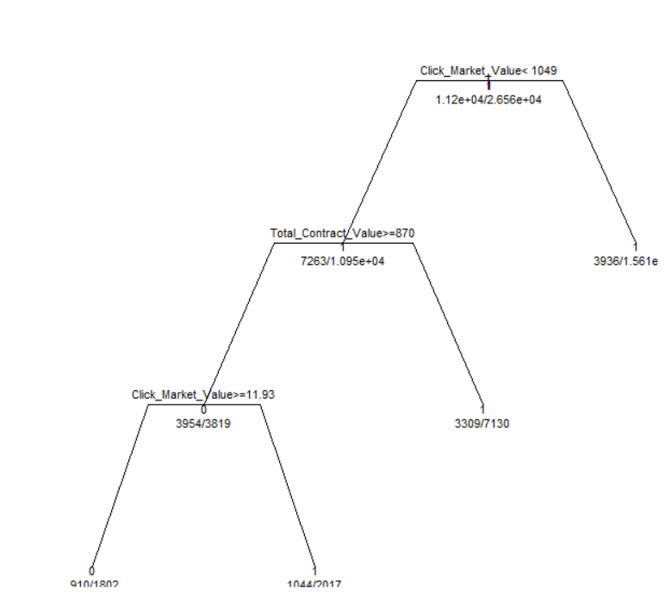
*CART model despite being simplistic, it shows that **CMV is a key indicator to predict renewal; Contracts with CMV greater than $1050 increases renewal likelihood
Click Market Value, the amount we claim the Employer has benefited from Glassdoor Job Slot Services in a month is the most critical component affecting the Subscription Renewal.
Based on the Analysis, Our future goal should be to target minimum Click Market Value of $1050 per Employer.
If we are unable to reach the target Click Market Value for a few months consecutively, we can think of giving our loyal customers bonus job slots or discounts on Contract Value for a month.
Train Accuracy of CART model : 74%
**CMV - Click Market Value, *CART : Classification and Regression Tree

Slide 5
Additional features that can enhance retention analysis are showcased below
Average monthly Click Rate Growth
Upgrades and Downgrades in Job Slots Package
Average New Customers added per month
Average Customer Churn Per Month
Fluctuations in Job Listings by an employer

